Slide 1
level 4/5 – group 10
Courtney-jade Pearson s185717 Thomas McCarthy s183168 Aaron kegge s186229

Slide 2
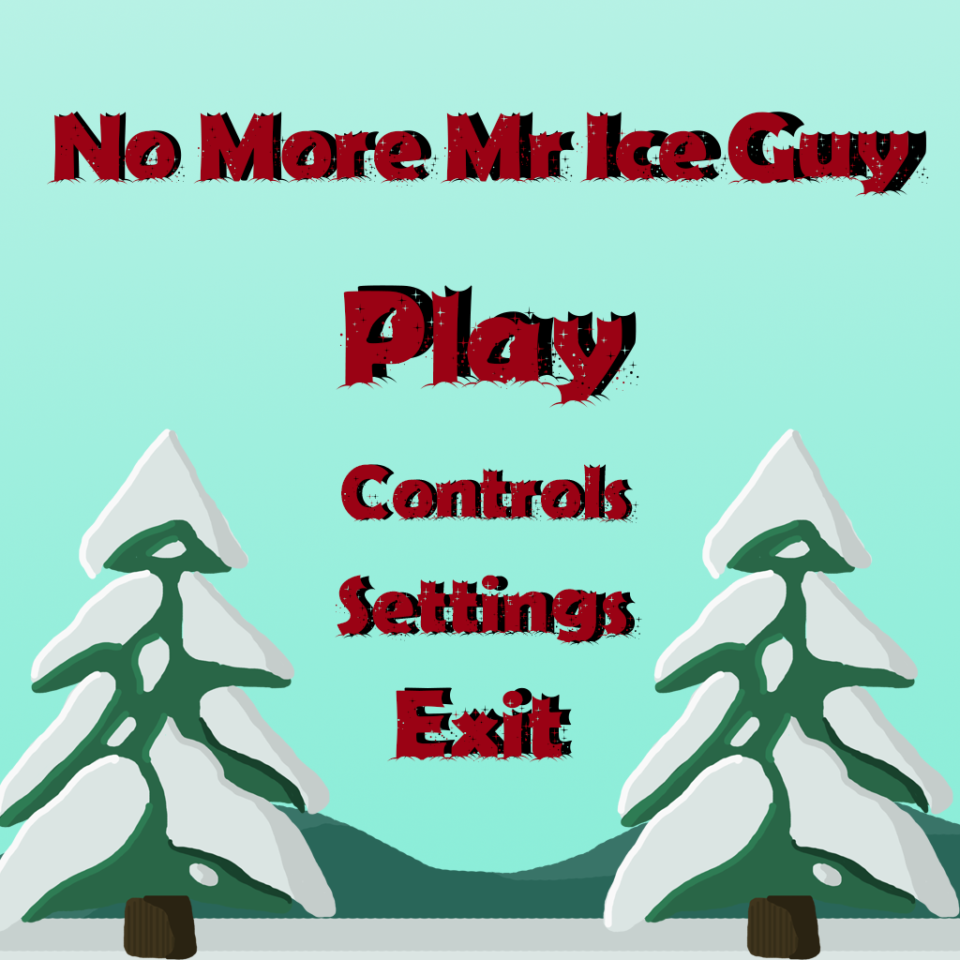
Genre / style
2D Platformer
Made for PC only
Competitive 2 players
Real time

Slide 3
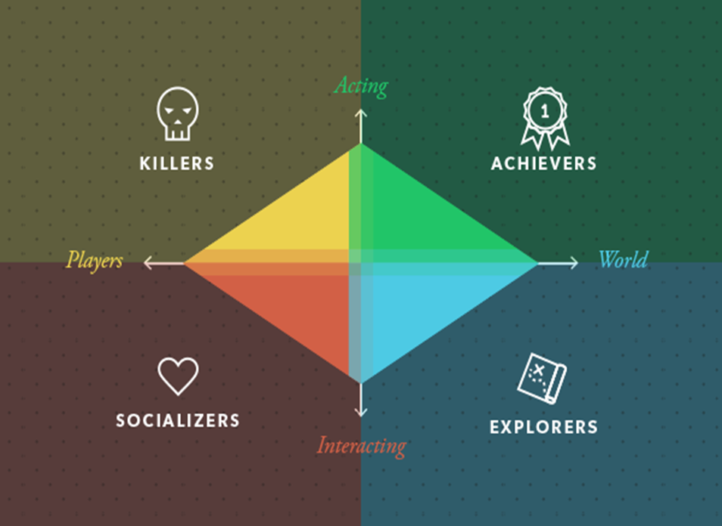
Target Demographic
Socializers
Age 16+
Gender: Males and Females

Slide 4
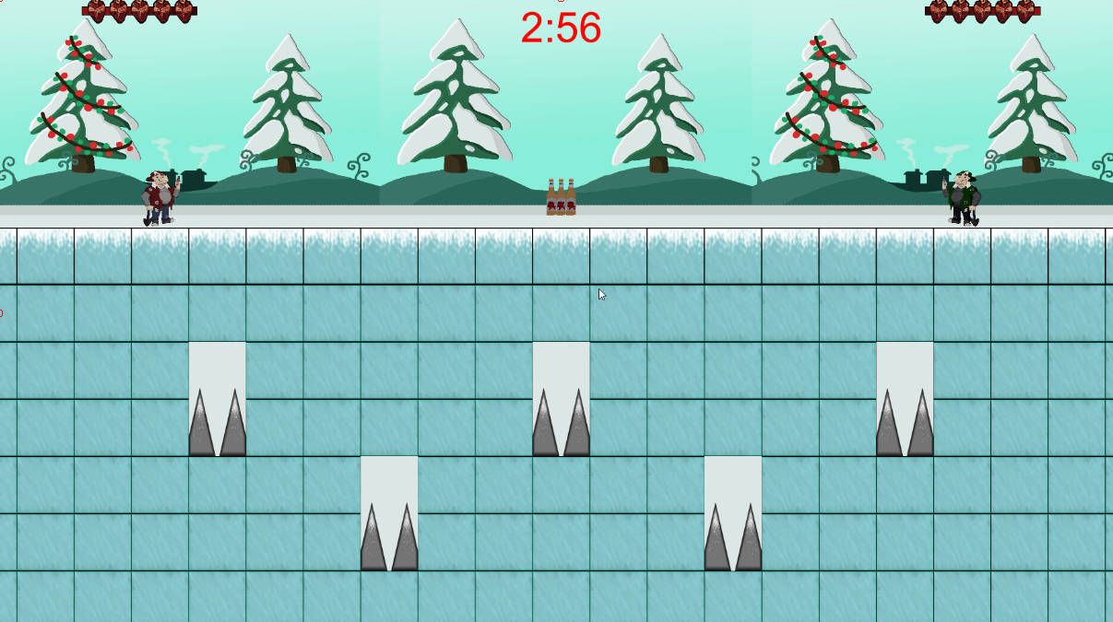
Visual hierarchy

Slide 5
How does our game relate to the brief?
2D environment
Gravity, Friction, Time
Adversarial – 2 players
Played on a single device
Symmetric Gameplay
Simple and intuitive rules

Slide 6
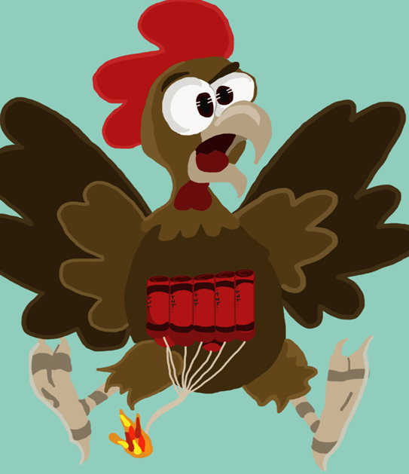
Mechanics
Symmetric mechanics
Damage
Timer
Wall jumping / double jumping
Health

Slide 7
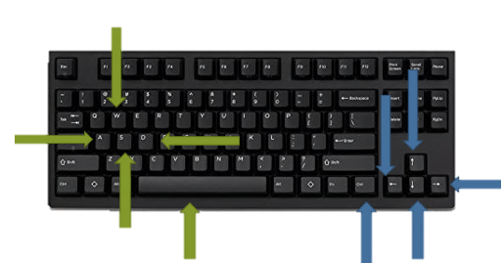
What does the player do?
Button press
Competitive
Reflex – Avoid Damage
Triumph

Slide 8
Prototype

Slide 9
Play testing feedback
Health Bar moves across the screen
Controls : Break down
Similar game play to worms
Need animation

Slide 10




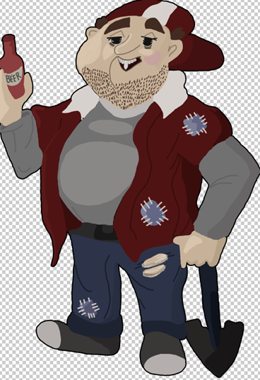
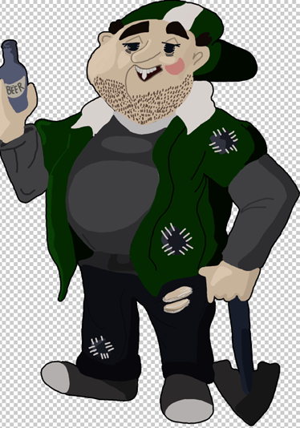


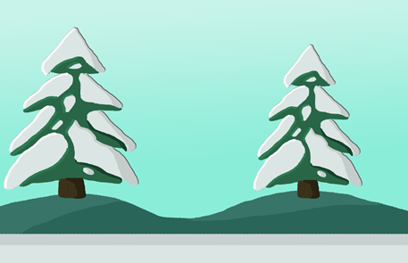

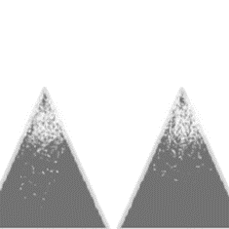
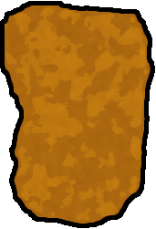

Art assets

Slide 11
What to expect in the final presentation
Polished health bar
Animation complete
Controls fixed

Slide 12
Any questions?

